Slide 1
Fluid simulation sandbox
Game Physics 2019 Mini Project
Reinier Reichert
Jan van Bergen

Slide 2
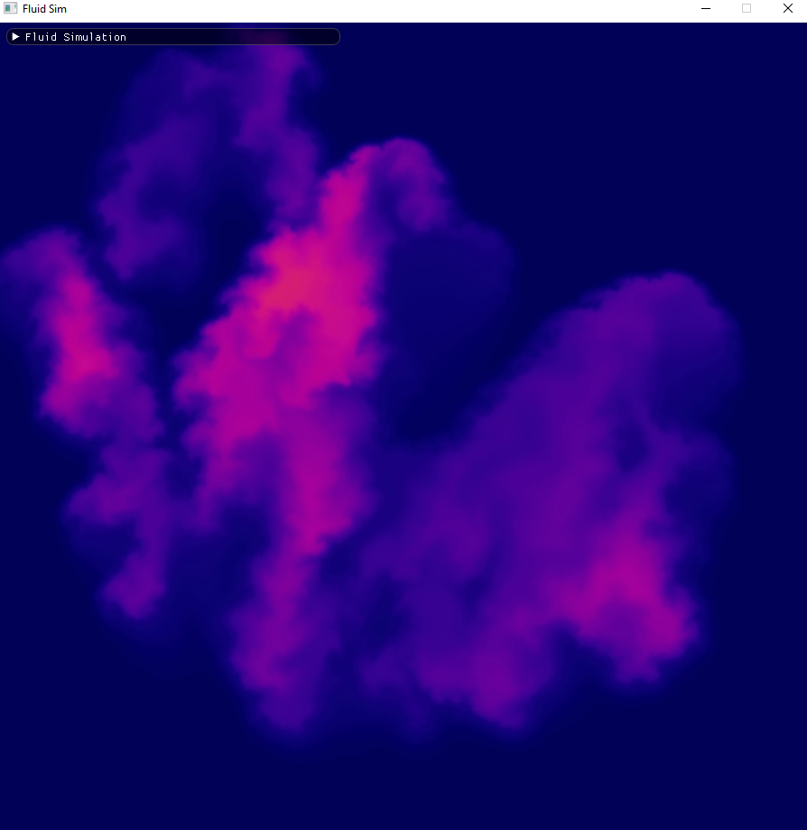
Based on “Stable Fluids” solver by Jos Stam
Semi-Lagrangian approach

